Slide 1
Vehicle Plate Recognition System
By:
Dinu V 1SI15EC028
Harshith C H 1SI15EC037
Santhosh Tuppad 1SI15EC089
Shreyas S Bagi 1SI15EC097
Under the guidance of :
Dr. R.Srikantaswamy
Professor
1

Slide 2
Overview
1
Introduction
Objective
Pre Processing
License Plate Extraction
Segmentation of Character
Feature Extraction
Classifier

Slide 3
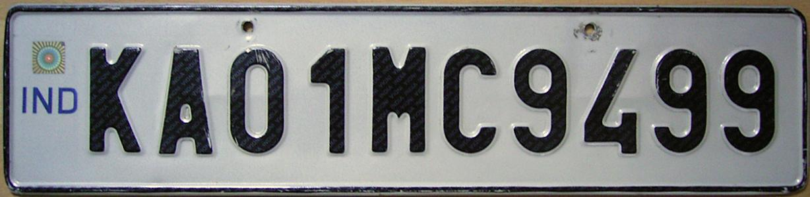
Introduction
License plate recognition system is the process of extracting the license plate and reading the characters from the license plate.
It can be used to:
Keeping the access diary
Law enforcements
Possibilities for analysis and data mining
Parking management

Slide 4
Objective
To implement the license plate extraction using python.
To test the project for the SIT main gate for vehicles entering and leaving the campus.
To keep the log of vehicles entering and leaving the campus with time.
Classify the vehicles as Registered and Not Registered.

Slide 5
Block Diagram
Image or video captured from the camera
Pre-processing
of image
License plate
extraction
Recognition Results in database
Feature Extraction
Segmentation
of characters
License plate number
Entry and Exit time
Registered or Not Registered

Slide 6
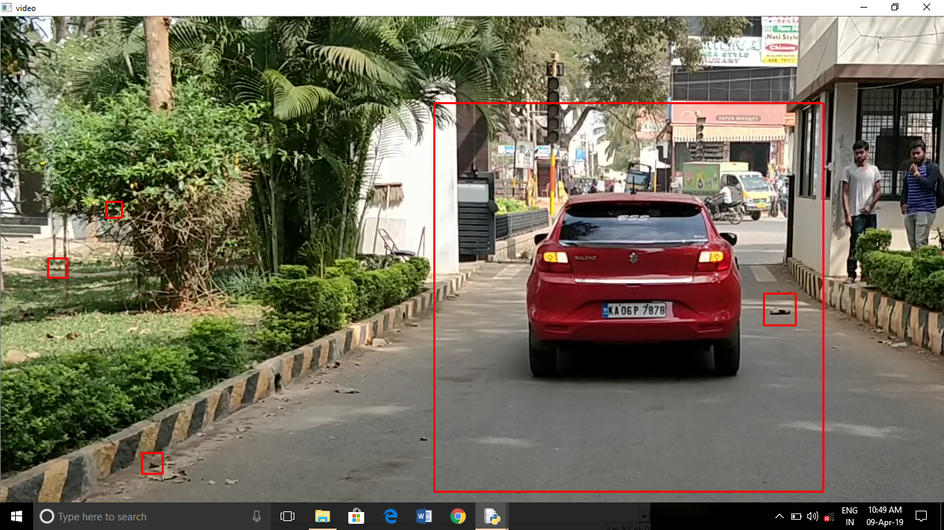
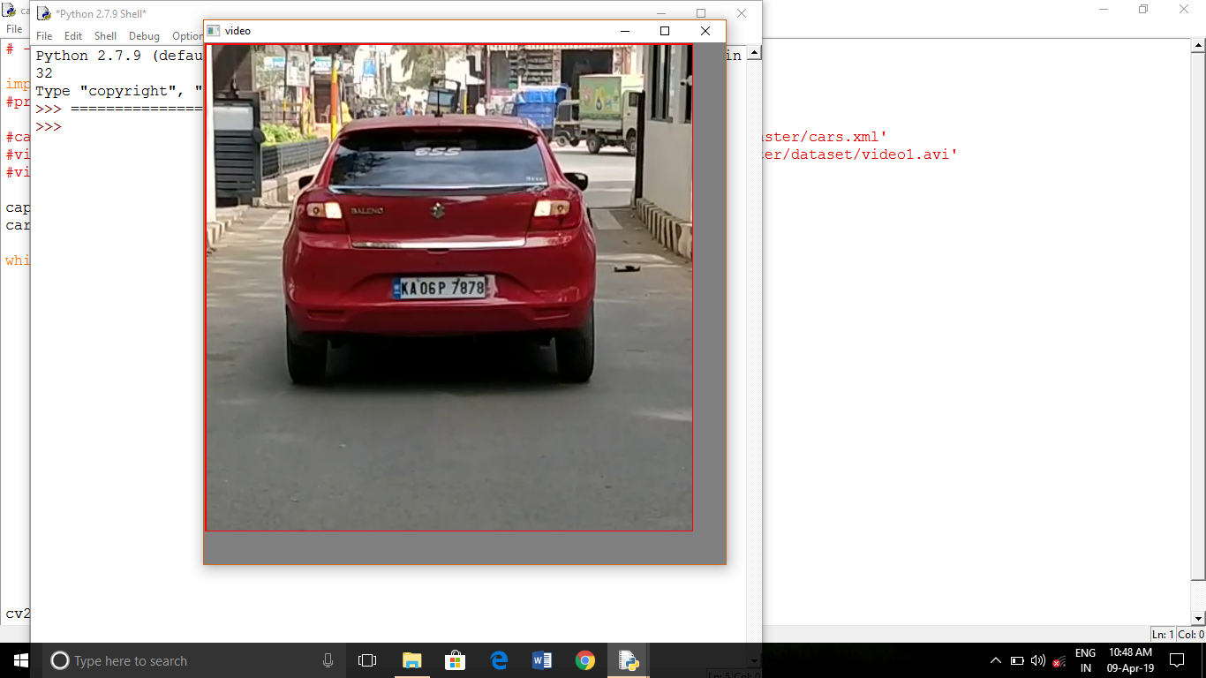
Video Analysis

Slide 7
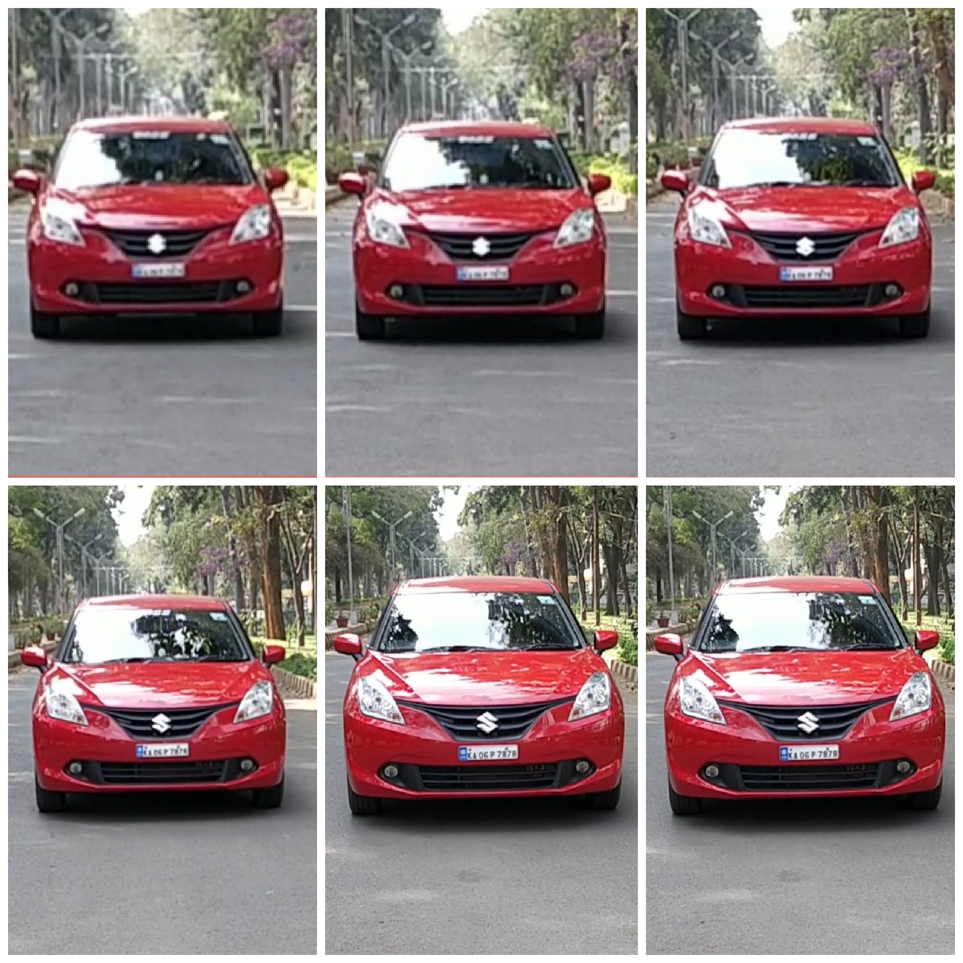
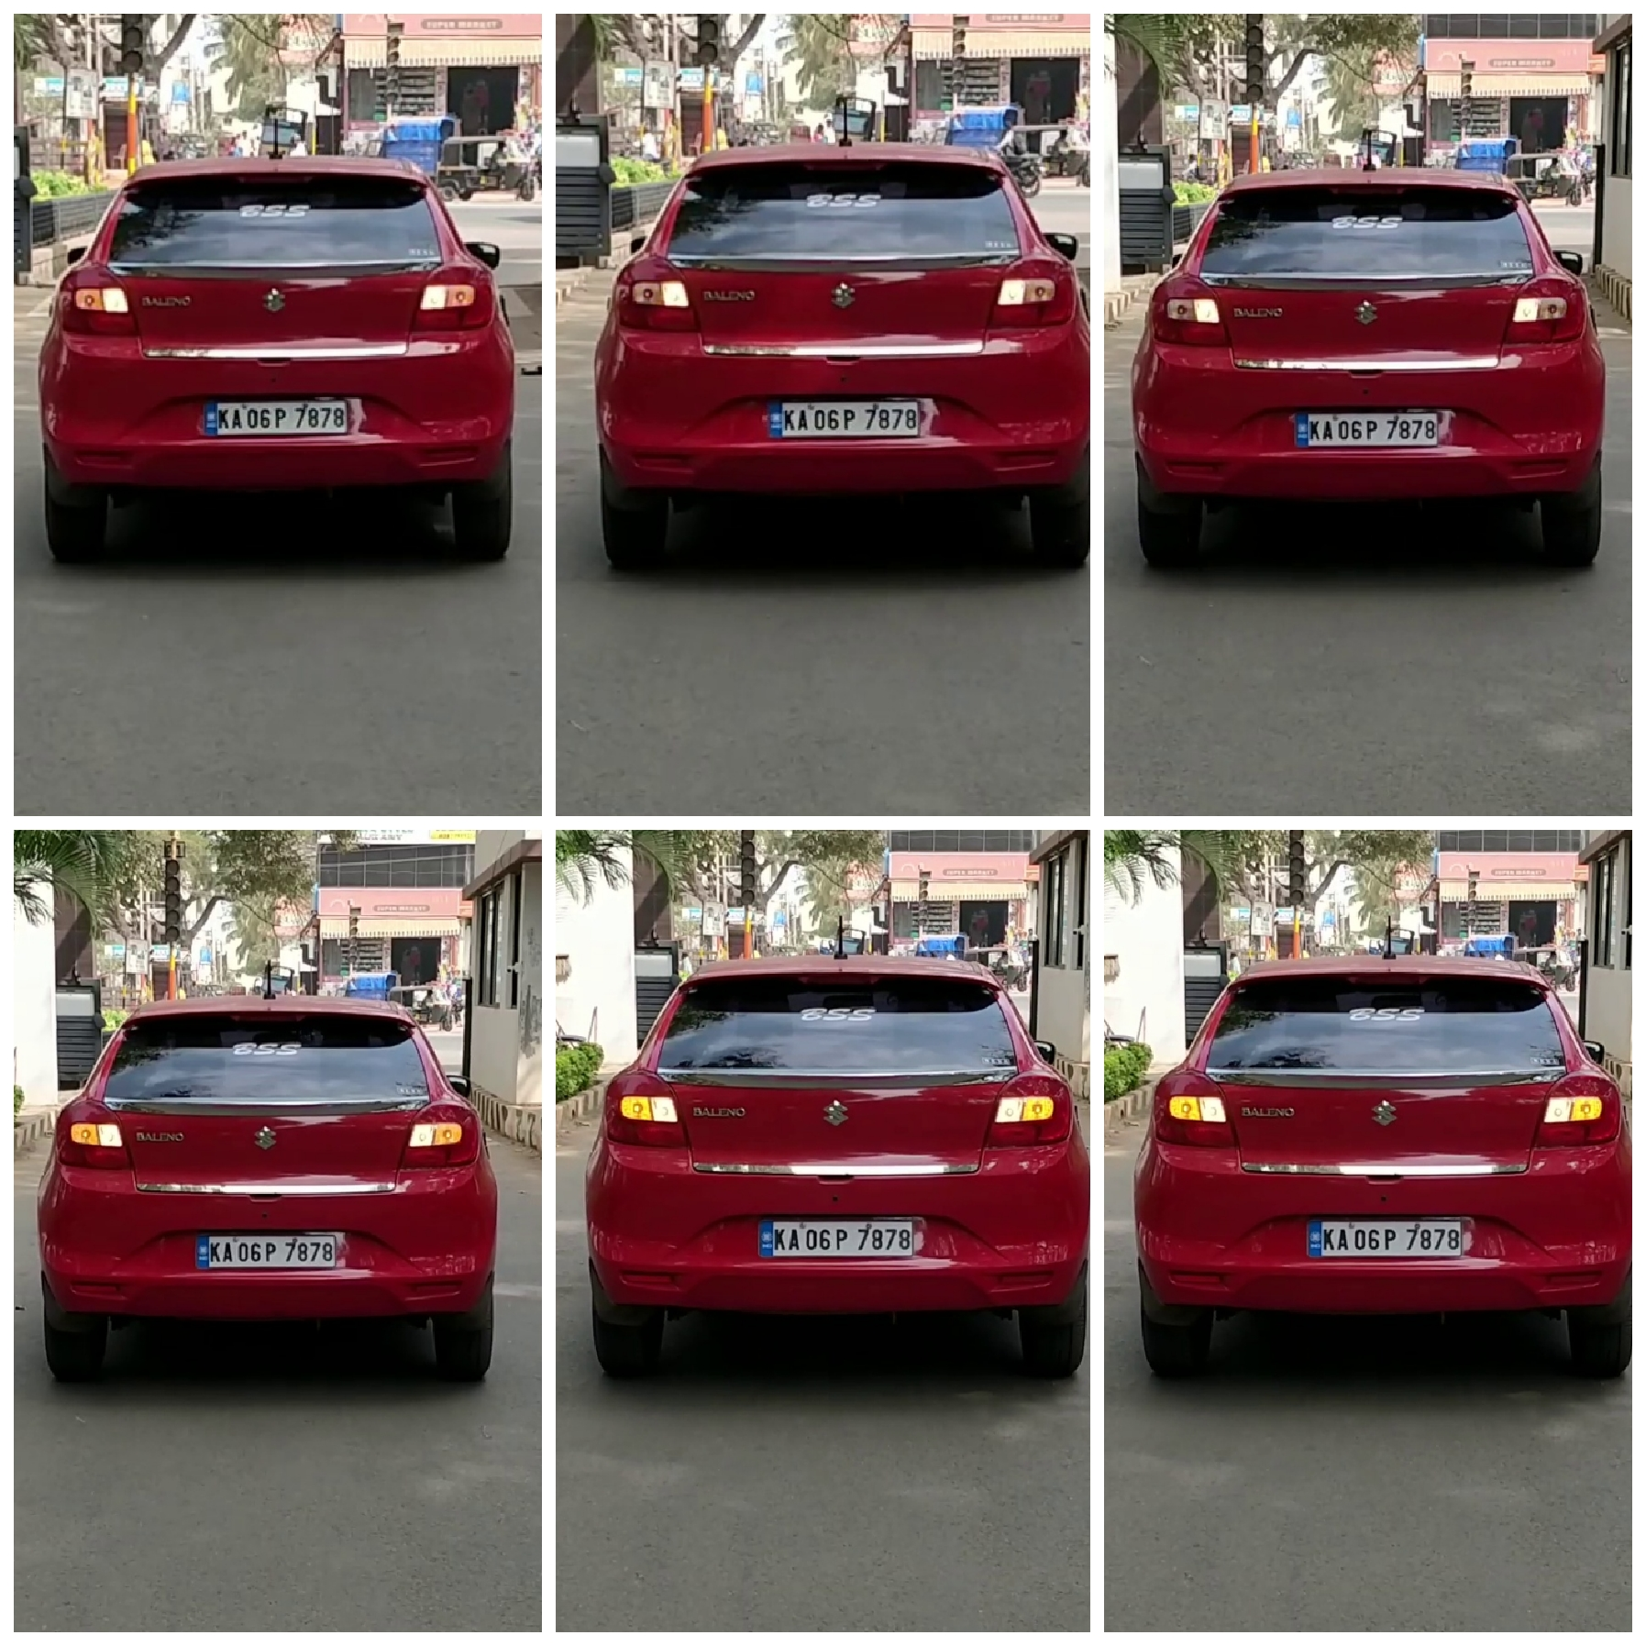

Slide 8
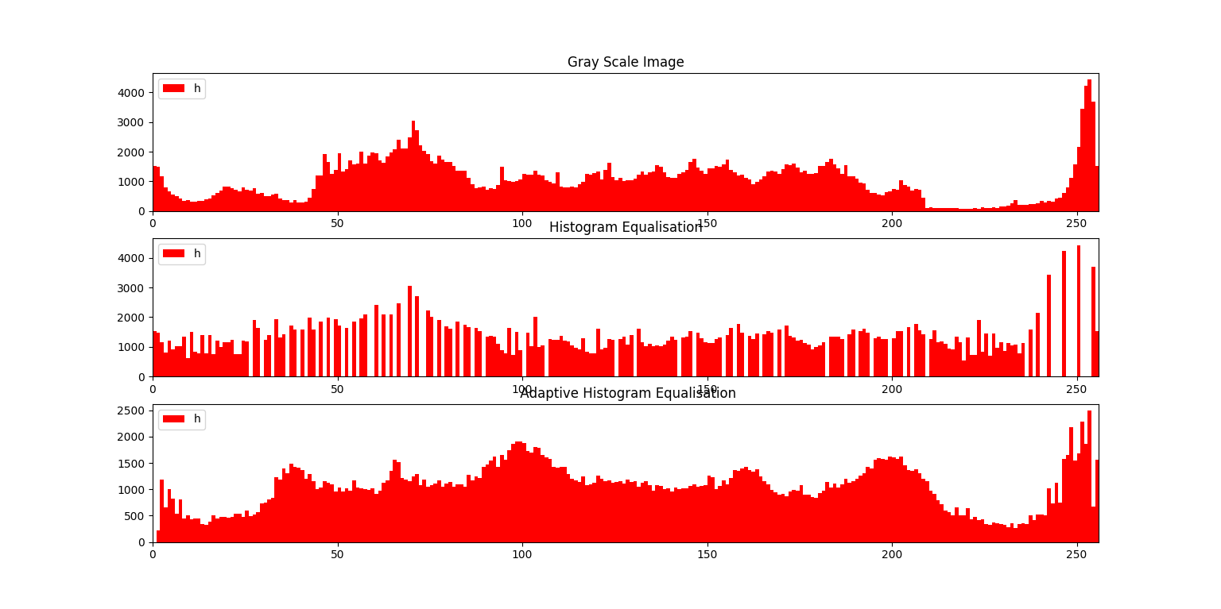
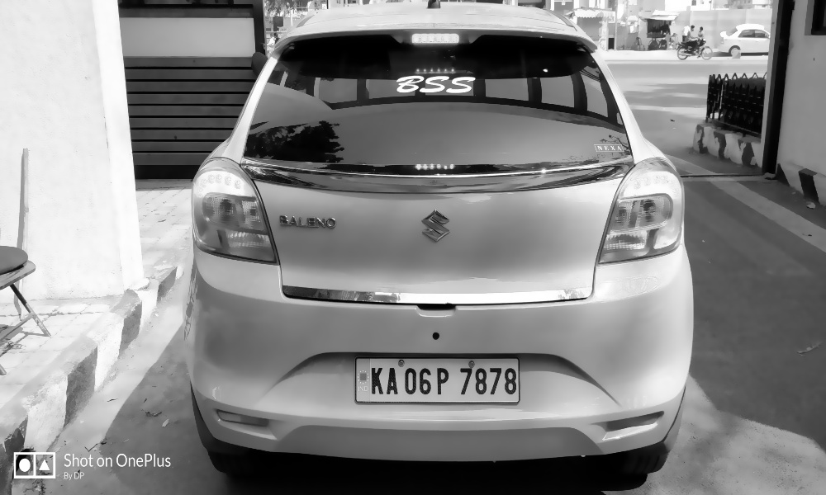
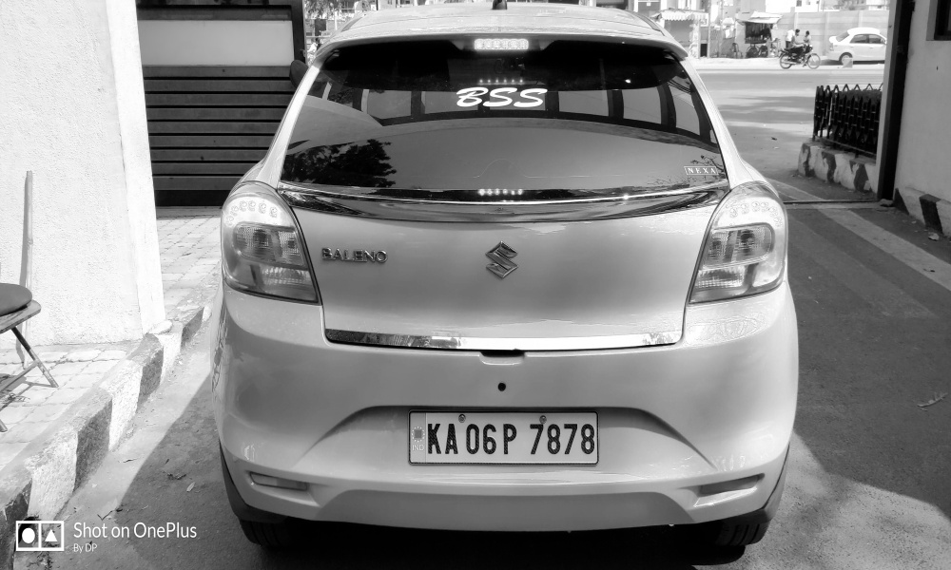
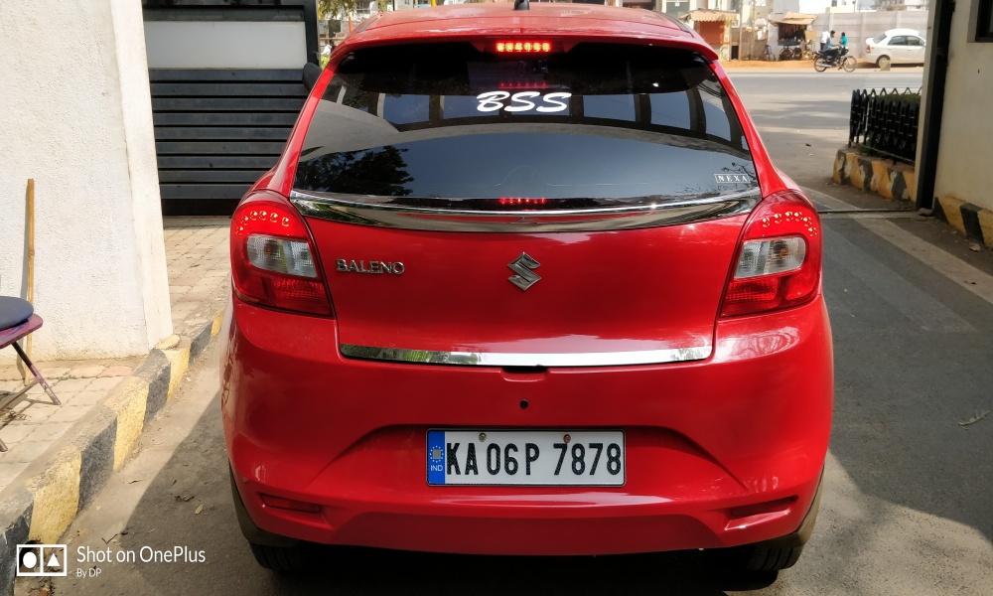
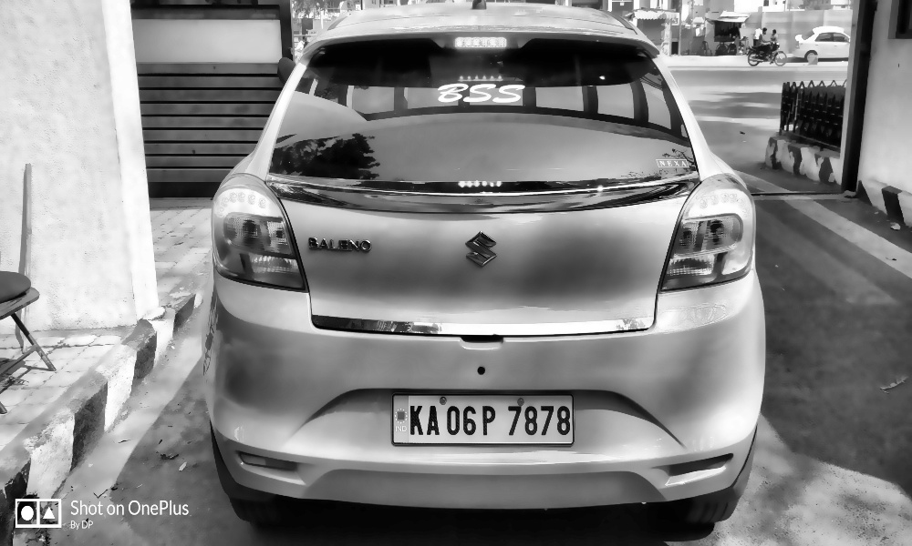
Pre-processing
Input Image
Gray Scale
Bilateral Filter
Adaptive Histogram Equalization

Slide 9
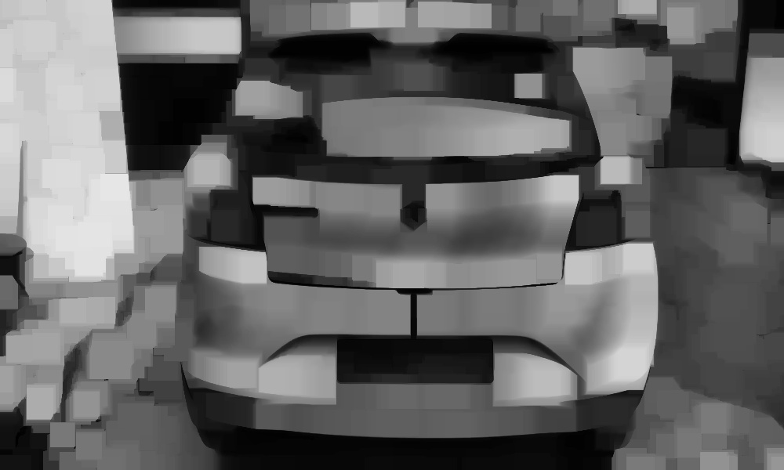
AHE Image
Opening

Slide 10
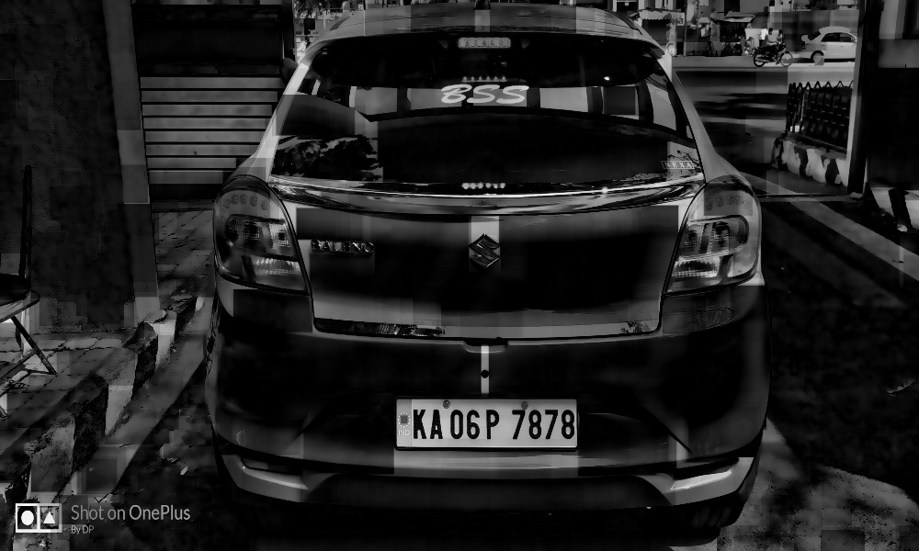
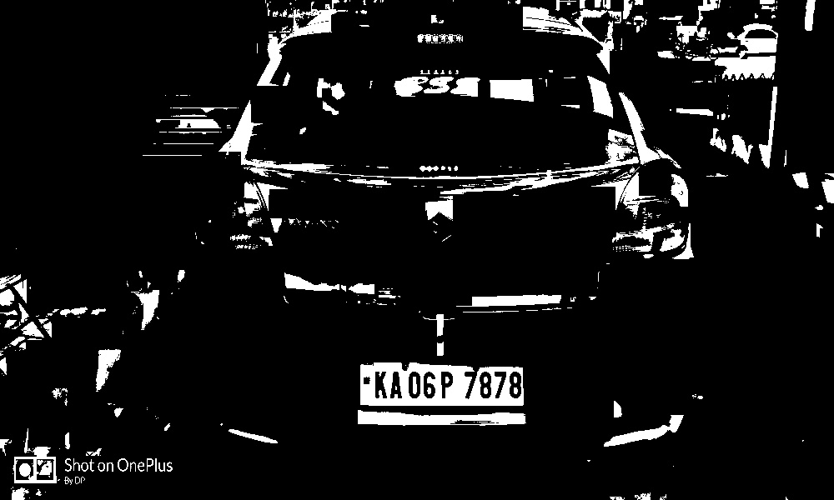
Difference
Threshold Image

Slide 11
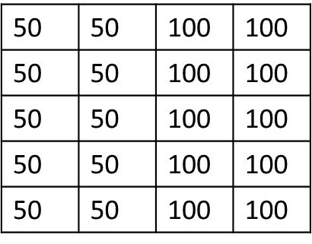
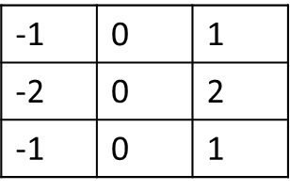
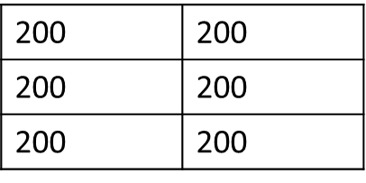
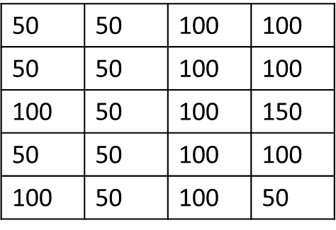
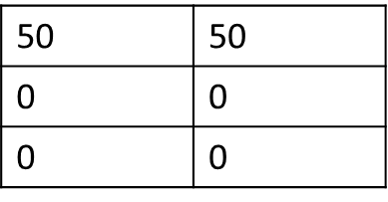
Edge Detection
Sobel Operator
1.Sobel along X-axis
=
kernel
2.Sobel along Y-axis
=
-1 | -2 | -1
0 | 0 | 0
1 | 2 | 1

Slide 12
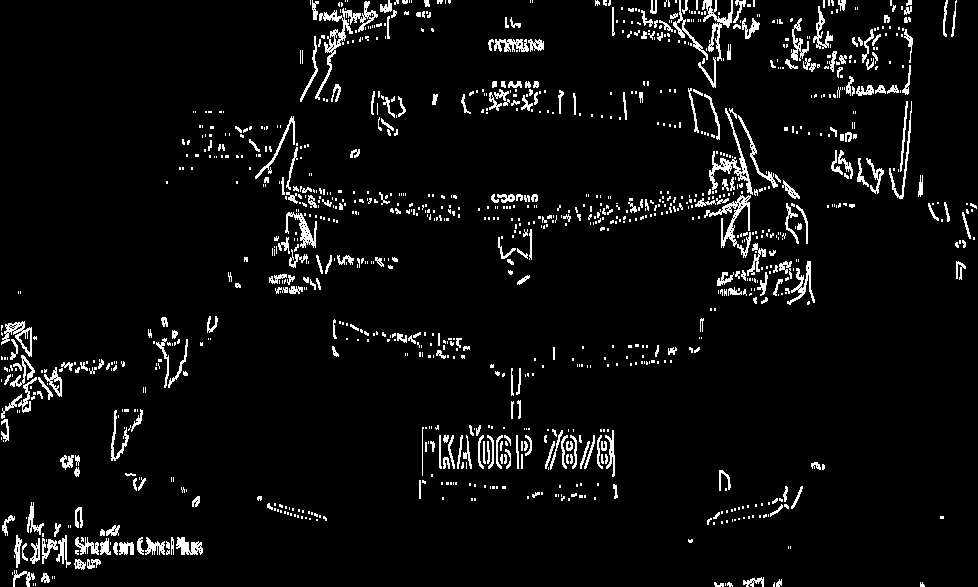
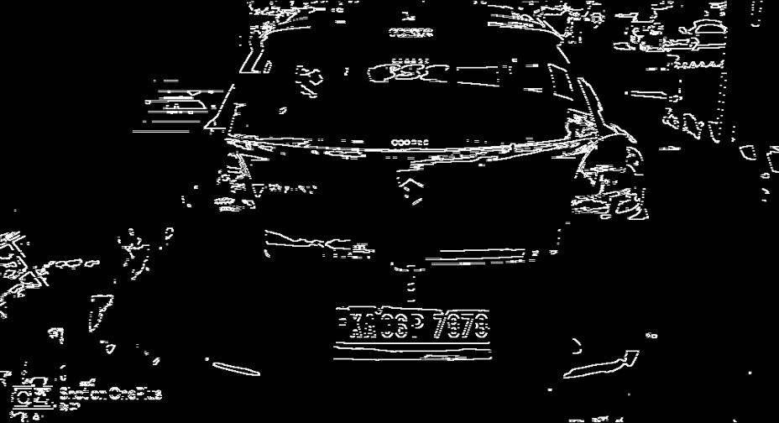
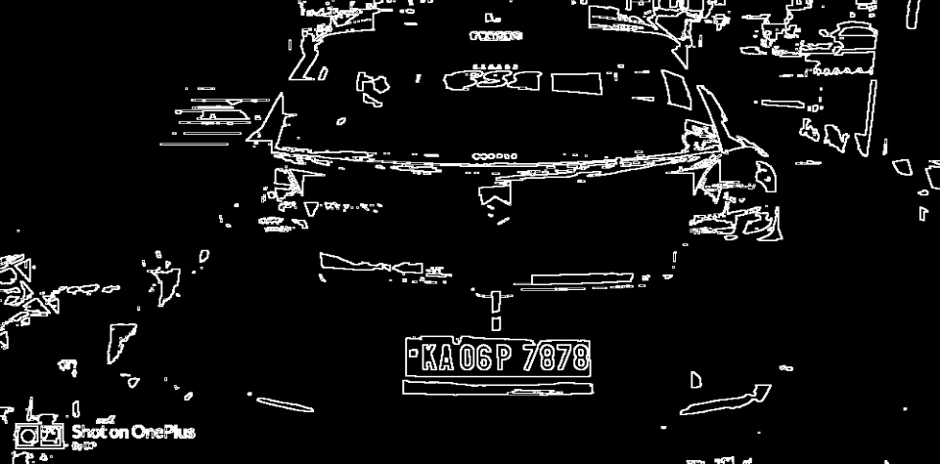
Contd..
Sobel-X Sobel-Y
Sobel operation whole

Slide 13
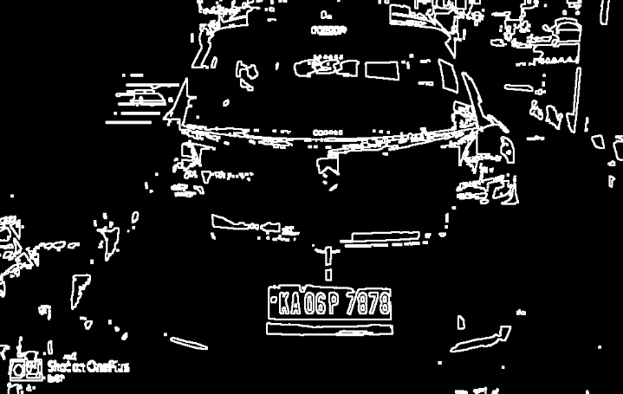
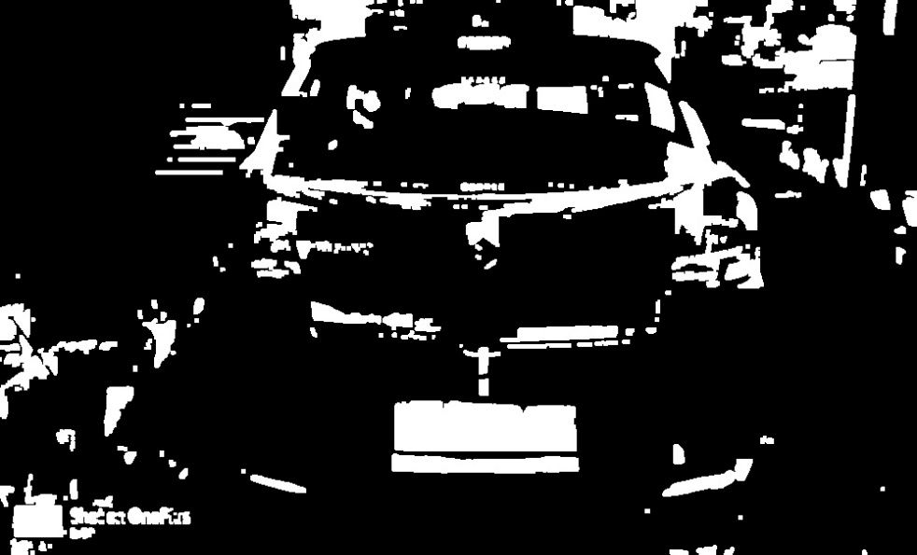
Dilation
original dilated
=
Hole filling
1 | 0
0 | 1
1 | 1
1
1
1
1 | 1
1 | 1
1 | 1

Slide 14
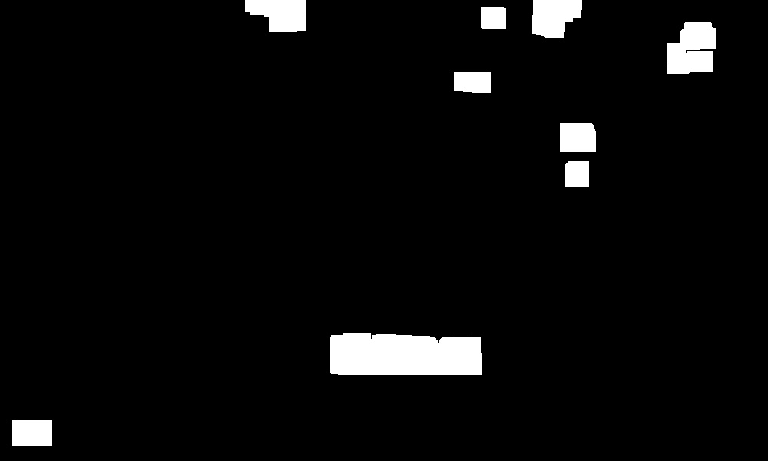

Opening:
Opened image
Erosion:
Eroded image

Slide 15
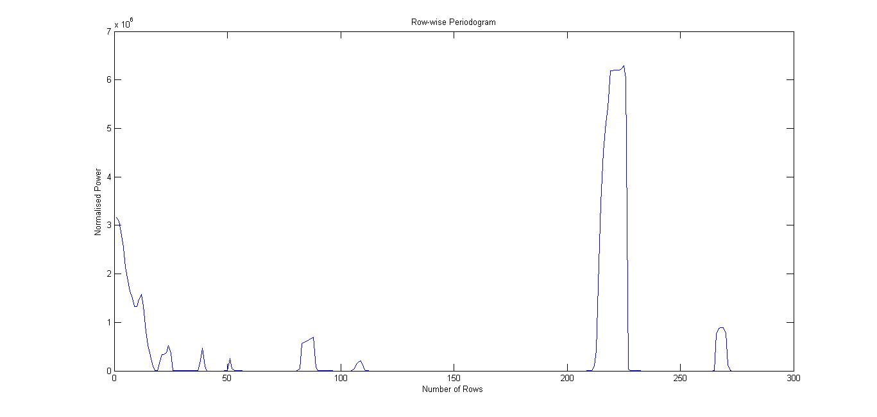
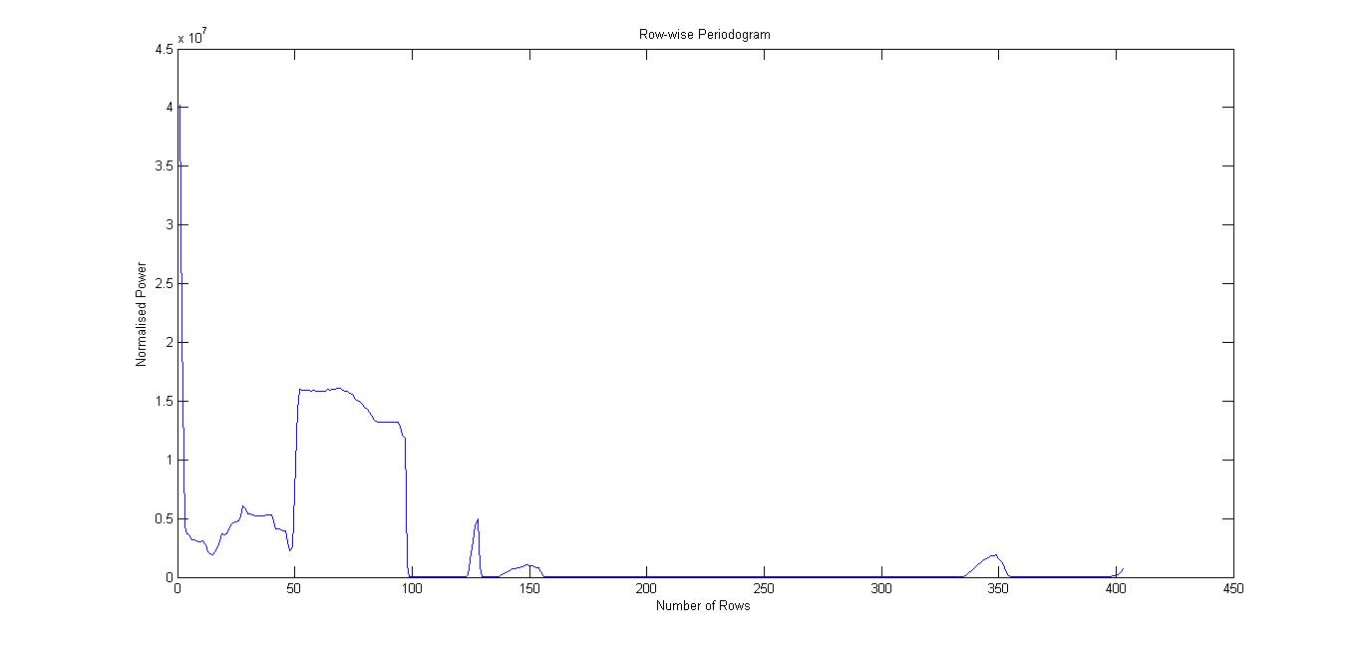

Row-wise Periodogram:
In this periodogram is plotted along the rows. The rows with the binary summed values are added and for that periodogram is plotted.
Rows like:
Based on the maximum value range periodogram with highest peaks is detected .
0 | 0 | 0 | 1
1 | 0 | 1 | 0
1 | 1 | 1 | 0
1 | 1 | 1 | 1
1 | 1 | 1 | 1
1 | 1 | 1 | 0
1 | 0 | 1 | 0
0 | 0 | 0 | 1
1
2
3
4
4
3
2
1

Slide 16
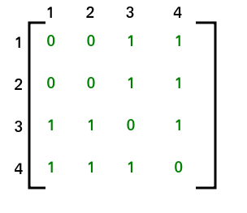
Connected Component Analysis
It is used to detect connected regions in binary digital images, although colour images and data with higher dimensionality can also be processed. Using x, y, width, height, and area we can grouped components into one.
4 - Connectivity
In this ones are present in large number by this we can infer the different component is present in the image.

Slide 17
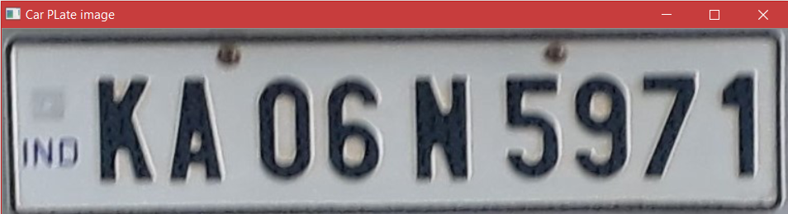
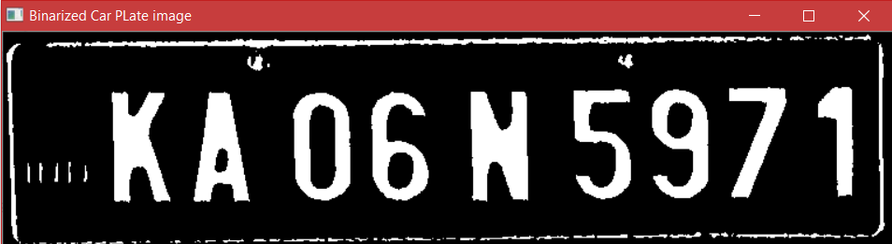
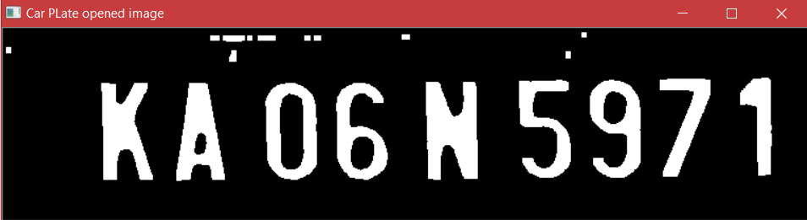
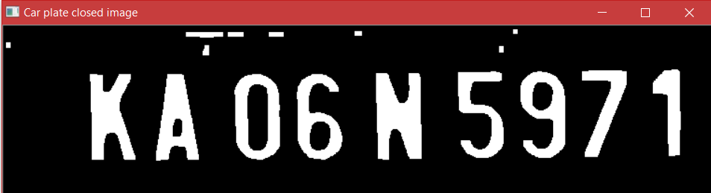
Segmentation of Character
License plate extracted will be resized.
Binarized car input image
Opened and Closed Car plate Image

Slide 18
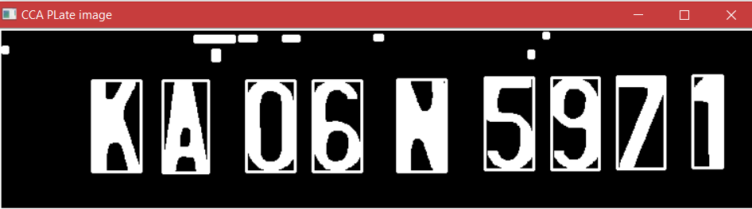
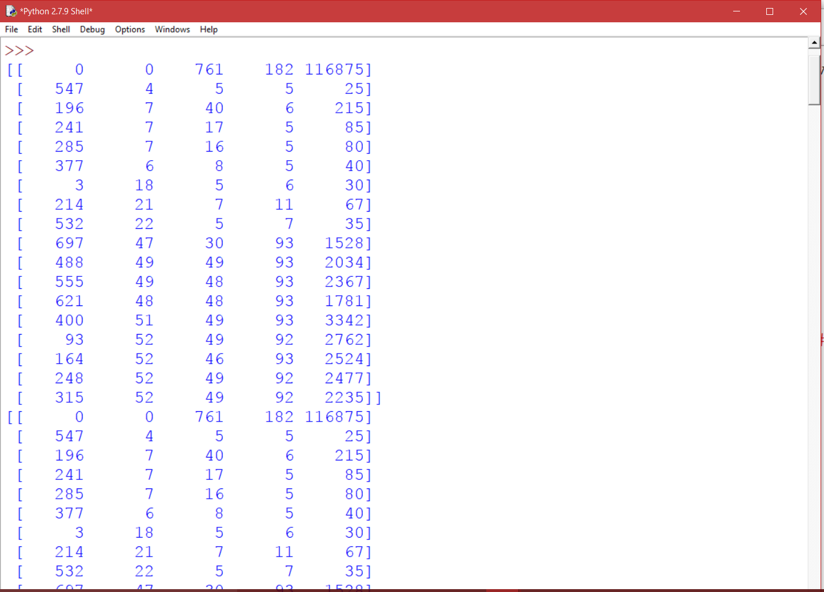
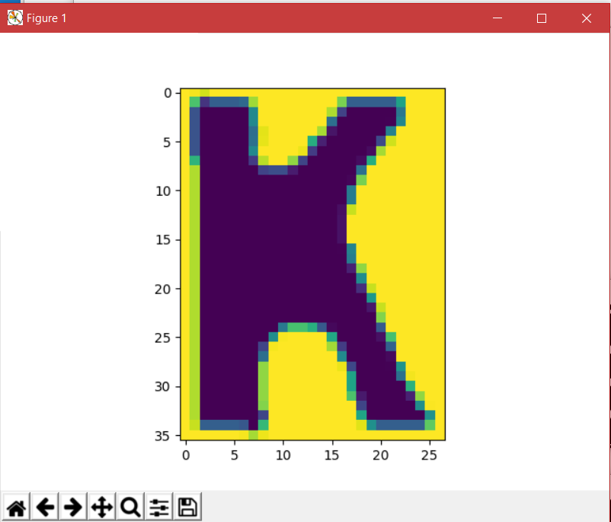
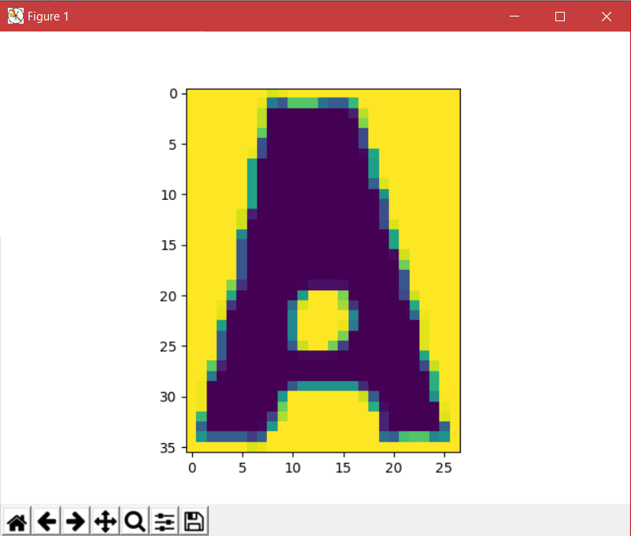
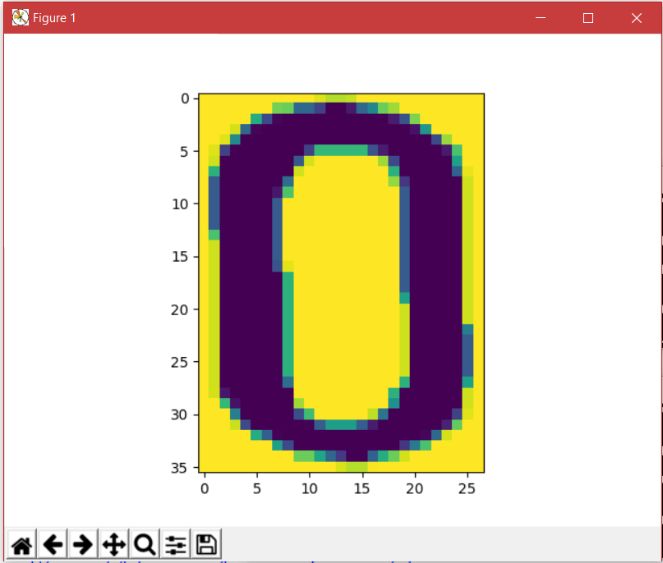
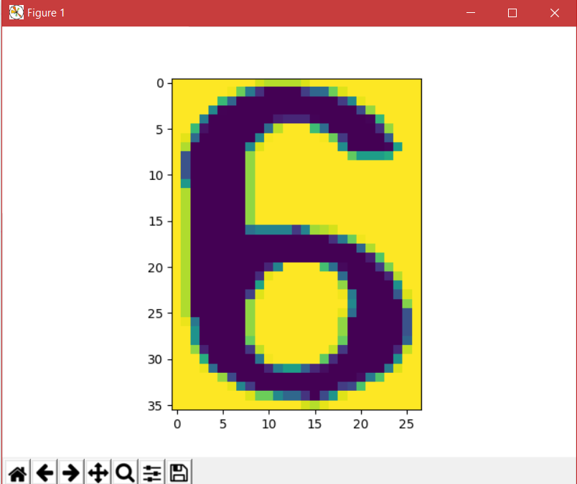
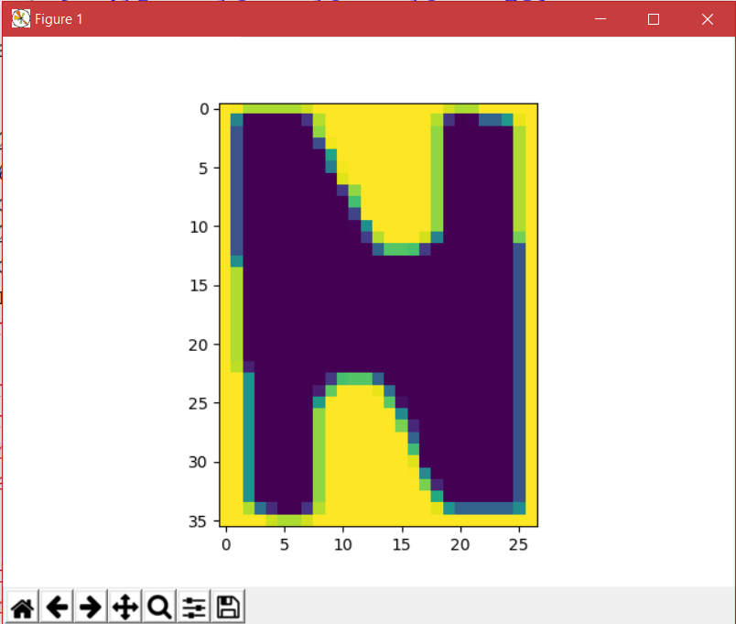
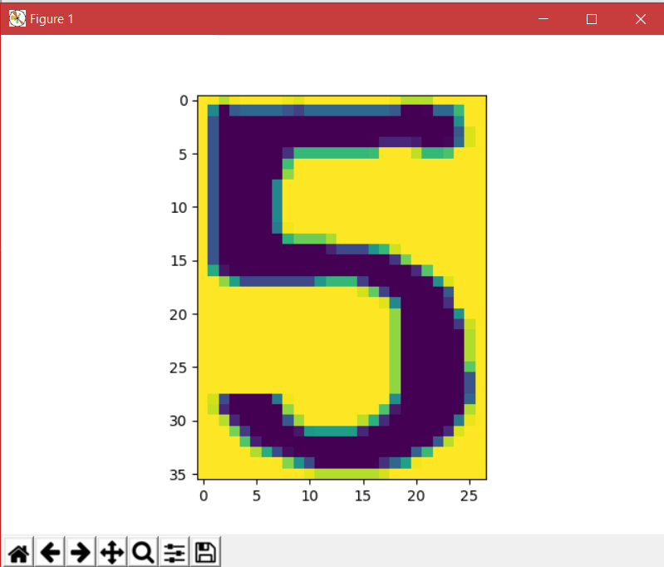
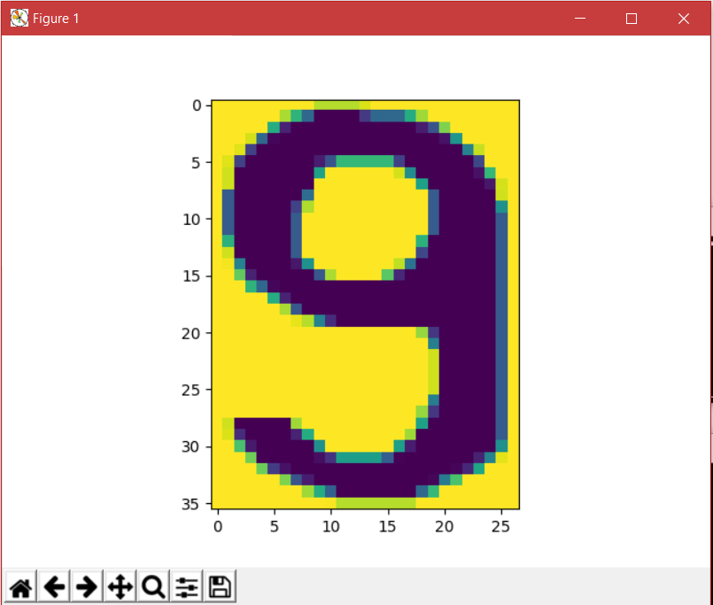
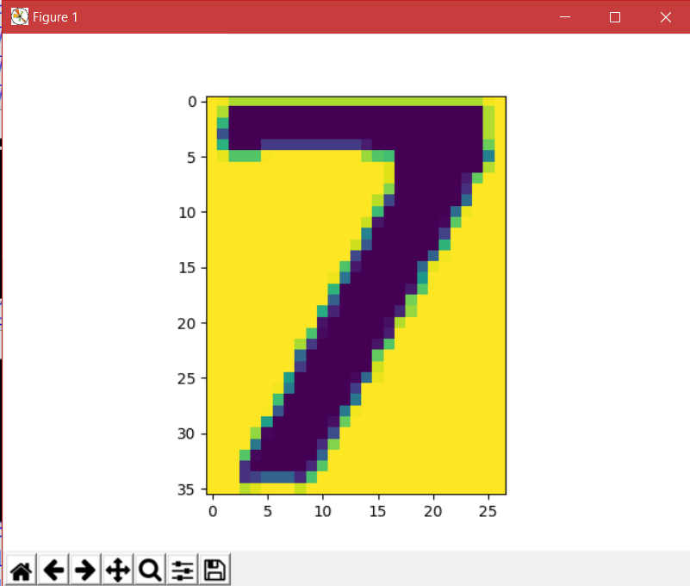
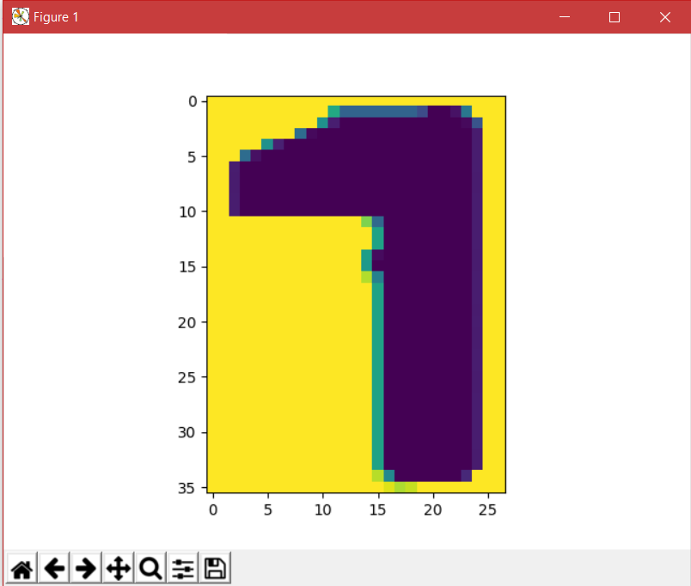
Cont.
CCA is applied to the car plate image.
Stats of CCA is obtained.
Based on aspect ratio, height, width
and area of connected components. The
alphanumeric numeric characters is
segmented.

Slide 19
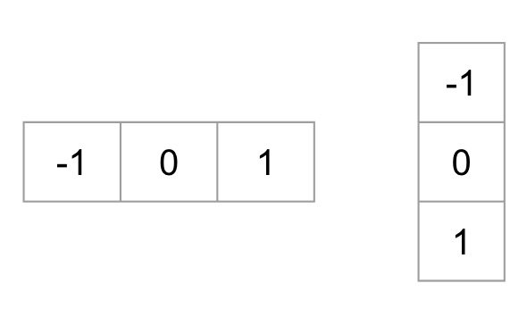
Feature Extraction
Feature Descriptor
Histogram of Oriented Gradients (HOG)
To Calculate Histogram of Oriented Gradients:
Pre-Processing step – Selection of an image size 27 X 36
Calculate the Gradient Images

Slide 20
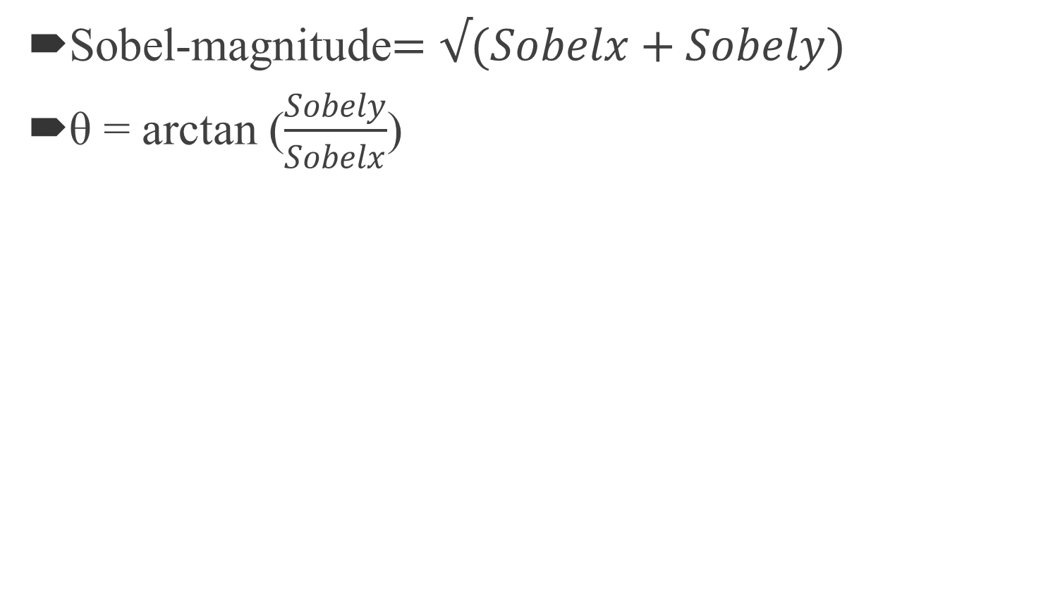
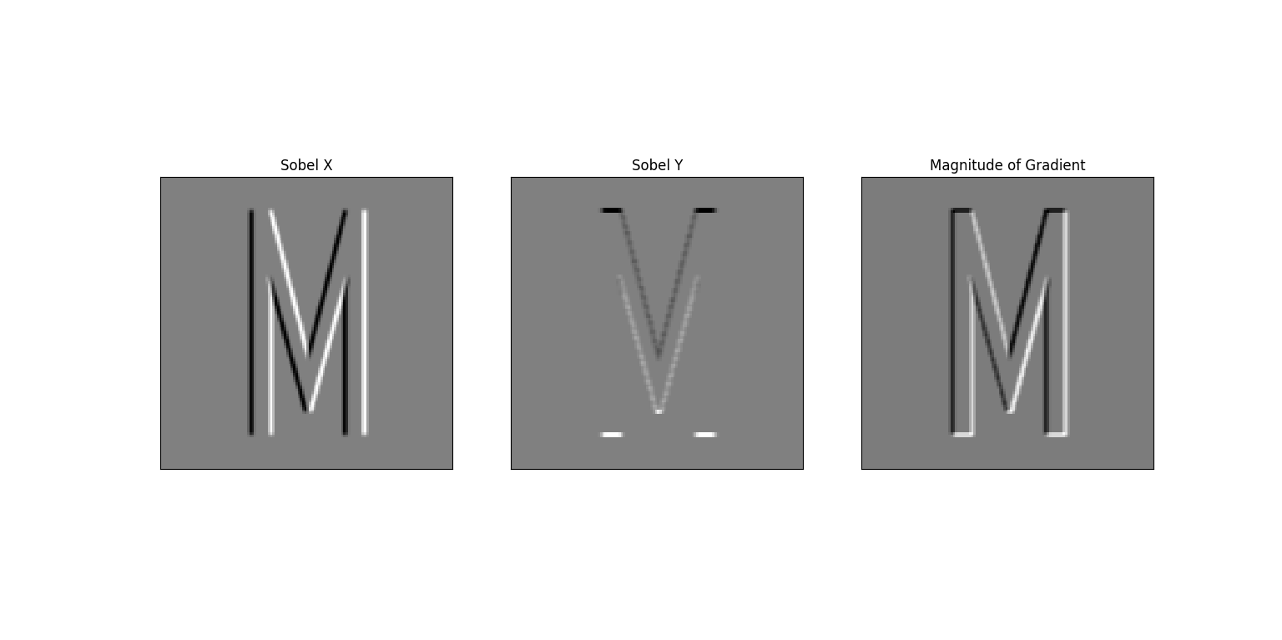

Slide 21
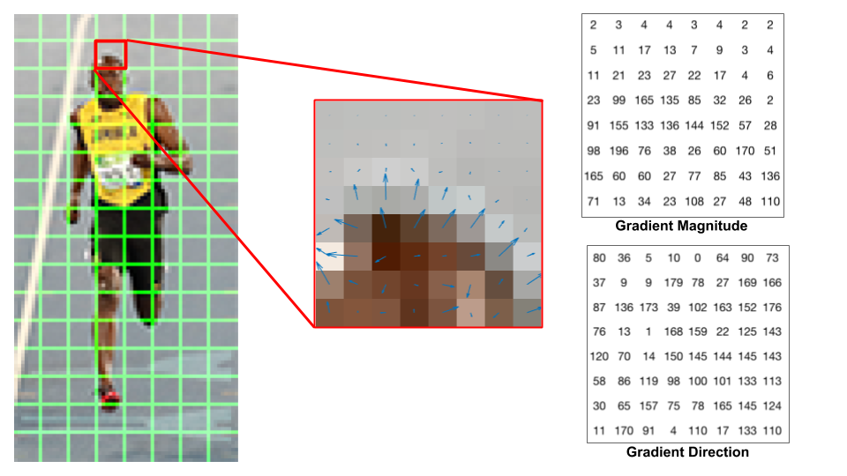
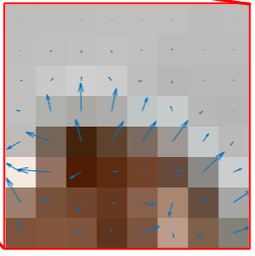
Histogram of Gradients 8 X 8 cells

Slide 22
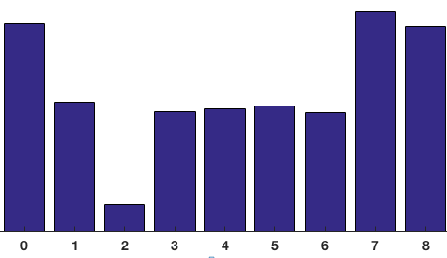
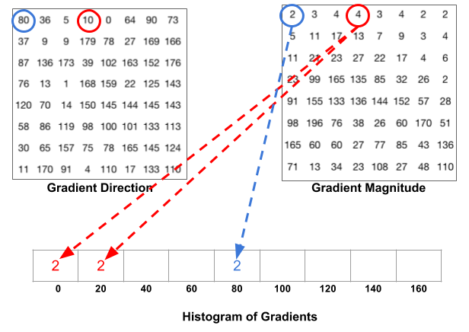

Slide 23
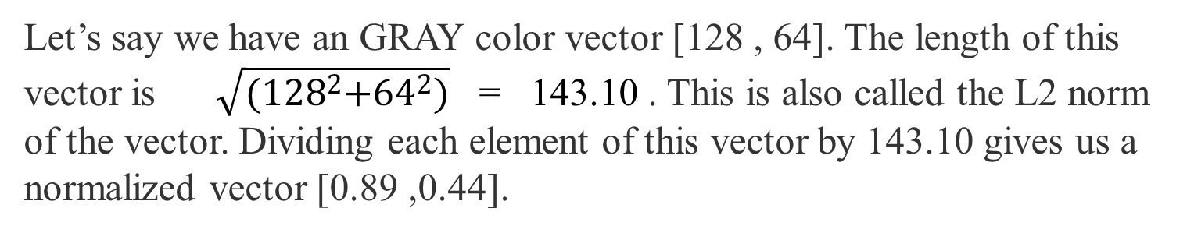

Block Normalization
There are 2 horizontal and 2 vertical positions making a total of 2 x 2 = 4 positions.
concatenate them all into one giant vector we obtain a 36×4 = 144

Slide 24


Feature Extraction
Feature Descriptor
Character – 0 Character - 0
Dimensional Vector: 972 Dimensional Vector: 144

Slide 25


SVM - Classifier
Binary classification can be viewed as the task of separating classes in feature space:
w^{T}x + b = 0
w^{T}x + b > 0
w^{T}x + b < 0
f(x) = sign(w^{T}x + b)
Notes:
1

Slide 26
Classification Margin
Distance from example x_{i} to the separator is
Examples closest to the hyperplane are support vectors.
Margin ρ of the separator is the distance between support vectors.
ρ
r
Notes:
<number>

Slide 27



Results

Slide 28



Slide 29
References
[1]Bhushan Pawar, Vikas T. Humbe, Laxmikant Kundnani, “Morphology Based Moving Vehicle Detection”, International Conference on Pattern Recognition (ICPR) 2013.
[2] Jie Cao, Li Li, “Vehicle Objects Detection of Video Images Based on Gray-Scale Characteristics”, International Workshop on Education Technology and ComputerScience 2009.
[3] Miao Ligang, Yue Yongjuan, “Automatic license plate detection based on connected component analysis and template matching”,IEEE International Conference on Intelligent Control and Information Processing, 01 September 2011.
[4] Preemon Rattanathammawat, Thanarat H. Chalidabhongse, “A Car Plate Detector
using Edge Information”, IEEE International Symposium on Communications and
Information Technologies, 02 April 2007.

Slide 30
[5] Chao Gou, Kunfeng Wang, Zhongdong Yu, Haitao Xie, “License plate recognition using MSER and HOG based on ELM ”,IEEE International Conference on Service Operations and Logistics, and Informatics, 20 November 2014.
[6] Amir Ebrahimi Ghahnavieh, Abdollah Amirkhani-Shahraki, Abolghasem A. Raie, “Enhancing the license plates character recognition methods by means of SVM ”,22nd Internatinal Conference on Electrical Engineering, January 2015.

Slide 31
THANK YOU

